Slide 1
Method of Contact
2021 – 2023

Slide 2
First Glance
Green is the highest number of customer contacts; red is the lowest.
Highest monthly contacts : Voice calls – 5,266,345
Lowest monthly contacts: Chat & Form contacts – 315,867
On an average month, State Farm receives:
About 4.5 million voice calls
About 781,000 chat & form contacts
About 800, 000 non-human/bot interactions

Slide 3
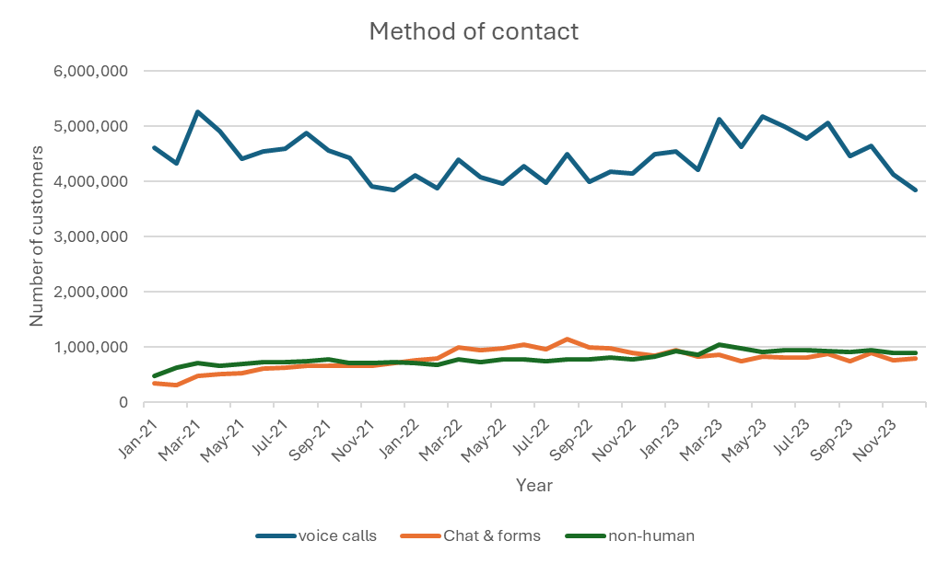


Visualizing the data
Customers are almost 6x more likely to call in than using chats & forms, and 5x more likely to call in than to use a bot.
Although voice calls are the preferred method of contact, customers are more likely to use a chat or form rather than to utilize non-human/bot interaction.
March has the highest voice call volume, with sporadic peaks during the summer months.
In 2023 voice calls spiked compared to the previous year.

Slide 4
Still visualizing the data
Although voice calls dominate as the preferred method of contact for customers, in 2021 and 2023, non-human interactions were preferred over chats & forms.
However, in 2022, chats & forums increased, gradually decreased and remained about the same throughout 2023.

Slide 5
Understanding the data
Potential questions
Why are voice calls the preferred contact method?
What caused the number of live calls to decrease in 2022?
Is there an opportunity to increase customer satisfaction?
Is there an opportunity to reduce hold times since customers prefer voice calls?
What are the next steps?
If majority of customers prefer voice calls, why do some prefer non-human interactions/bots over chat & form interactions?
What does the data mean?
Customers are 468% more likely to use voice calls over chat & forms.
Customers are 456% more likely to use voice calls over non-human/bot interactions
Although customers prefer voice calls as a contact method, they’re 2% more likely to use non-human interactions/bots over chats & forms.
Contact centers should not be understaffed
People prefer talking to a person vs other methods of contact
Something happened in 2022 that increased the number of customers that used chats & forms
Something happened in 2021 and 2023 that increased the number of customers that used non-human interactions and bots

